Slide 1
IBM University Engagement Project Submission
“Exploring the Power of Agentic AI with IBM Granite and IBM Bob”

Slide 2

Project Tile :– Agentic AI for Mental Health Awareness & Suicide Prevention
Domain of Project :– Healthcare
Student Name | Recent Passport Photo | Email ID | Mobile number [WhatsApp]
Shreni Mahadik |  | shreni.mahadik25@mmit.edu.in | 9130192172

Slide 3
Problem Statement -
Problem Statement : Agentic AI for Mental Health Awareness & Suicide Prevention
The Challenge
Mental health issues such as depression, anxiety, and suicidal thoughts are growing worldwide. Stigma, lack of awareness, and limited access to timely help prevent many individuals from seeking support. Traditional systems are often reactive, leaving gaps in early detection and preventive care.
The Objective
Build an Agentic AI-powered Mental Health Awareness & Suicide Prevention Agent that is empathetic, proactive, and safe. The solution should:
1. Promote Awareness & Education – Share accessible resources on mindfulness, coping strategies, and self-care.
2. Enable Early Detection (RAG) – Use Retrieval-Augmented Generation to identify distress signals in conversations, journaling inputs, or safe online data.
3. Provide Empathetic Support – Build a conversational agent that listens actively and responds with empathy (with clear disclaimers: not a substitute for professional medical advice).

Slide 4
4. Predict & Prevent Risks – Forecast stress peaks, suggest preventive strategies, and issue alerts when high-risk signals are detected (with consent).
5. Connect to Human Support – Link users to helplines, counselors, or community support for timely intervention.
Tech Stack (Mandatory)
• IBM Langflow / IBM Orchestrate + IBM Models

Slide 5
Proposed Solution -
Proposed Solution: Agentic AI for Mental Health Awareness & Suicide Prevention
The proposed solution is an Agentic AI-powered Mental Health Awareness & Suicide Prevention Agent built using IBM Langflow/IBM Orchestrate and IBM Models. The solution promotes mental health awareness, enables early detection of distress, provides empathetic support, predicts potential risks, and connects users with professional help when needed.
The system leverages a Retrieval-Augmented Generation (RAG) pipeline to retrieve trusted information from verified mental health resources such as WHO, NIMH, and counseling guidelines. The knowledge is stored in a vector database, allowing the AI to provide accurate, context-aware, and reliable responses.
The solution consists of five AI agents:
Awareness & Education Agent: Shares resources on mindfulness, stress management, coping strategies, and self-care practices.
Early Detection Agent (RAG): Analyzes conversations, journaling inputs, and mood patterns to identify early signs of stress, anxiety, depression, or emotional distress.
Empathetic Support Agent: Provides compassionate conversations, active listening, and evidence-based wellness suggestions, while clearly stating that it is not a substitute for

Slide 6
Empathetic Support Agent: Provides compassionate conversations, active listening, and evidence-based wellness suggestions, while clearly stating that it is not a substitute for professional medical advice.
Risk Prediction & Prevention Agent: Forecasts stress peaks, recommends preventive actions, and issues alerts when high-risk signals are detected, with user consent.
Human Support Agent: Connects users to helplines, counselors, trusted contacts, or community support for timely intervention during critical situations.
A user-friendly dashboard built with React or Streamlit visualizes mood trends, wellness scores, journaling history, and personalized recommendations.
IBM Langflow/IBM Orchestrate manages the workflow between AI agents, while IBM Models power reasoning, sentiment analysis, summarization, and personalized responses. The platform also incorporates responsible AI practices, user privacy, consent management, and AI governance to ensure safe and trustworthy interactions.
Overall, the solution delivers an intelligent, empathetic, and proactive mental health assistant that combines Awareness & Education, Early Detection (RAG), Empathetic Support, Predict & Prevent Risks, and Human Support, helping users improve mental well-being through timely guidance and preventive care.

Slide 7
Technology Used
IBM Bob platform -For designing and orchestrating multi-agent workflows visually
IBM Grainte model - for eg – ibm-granite-3-2-8b – For natural language understanding, reasoning, and personalization
IBM Cloud – It provides the infrastructure to build, deploy, and scale the Nutrition Agent efficiently. IBM Cloud enables a reliable, secure, and scalable environment for deploying the Nutrition Agent.
RAG– RAG to fetch real data first, then generate intelligent answers, making the Nutrition Agent more trustworthy and effective.
IBM Watsonx.ai - For model deployment, embeddings, and AI governance
Vector Database (FAISS/Chroma) – For RAG-based nutritional data retrieval

Slide 8
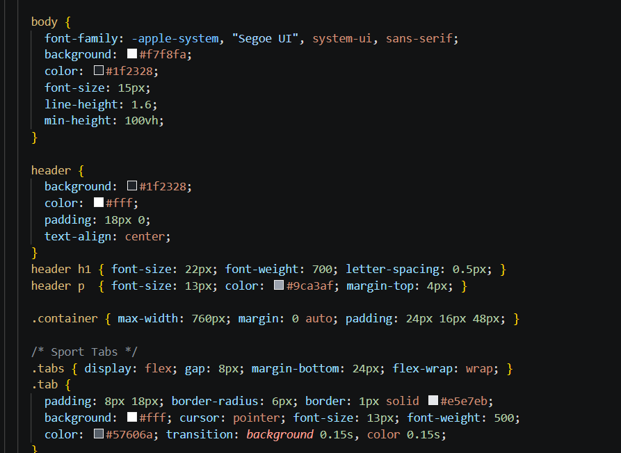
Required Files created using IBM bob -
Index.html

Slide 9
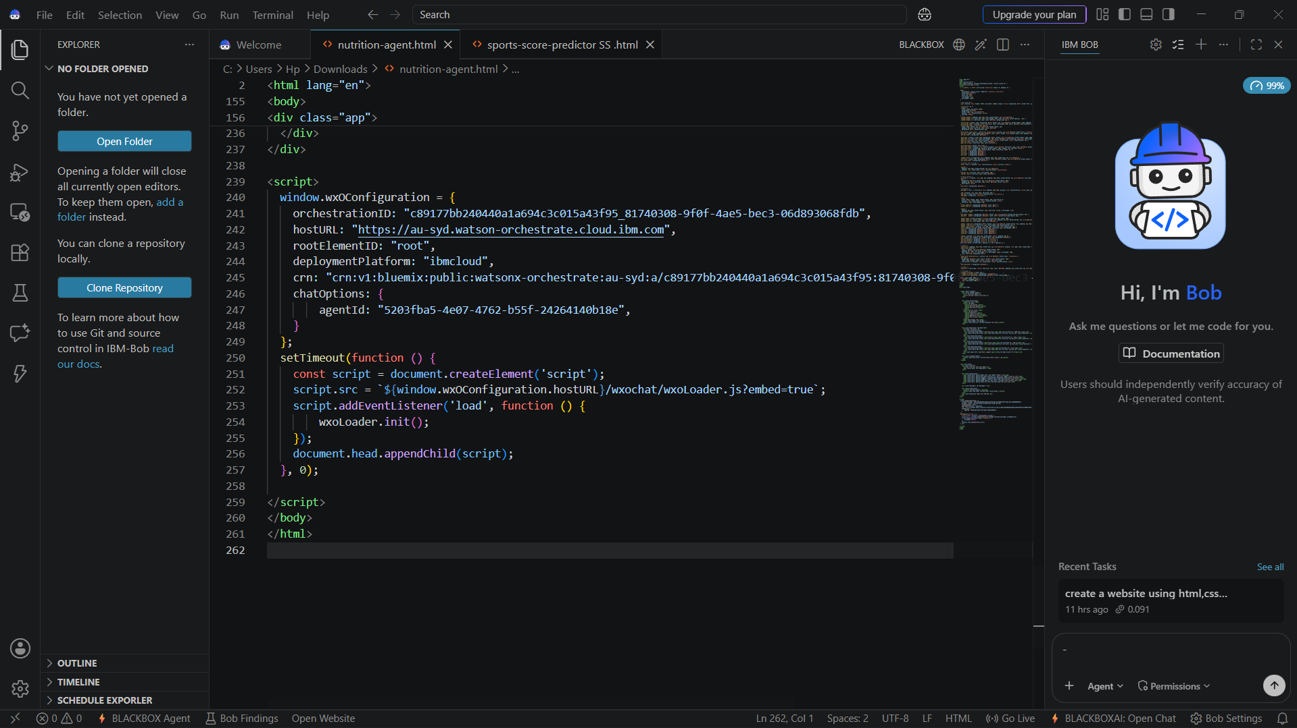
IBM Bob Screenshots :

Slide 10

Architecture blueprint for IBM bob :

Slide 11

Role of Agentic AI in the solution
Role of Agentic AI in Mental Health Awareness & Suicide Prevention Agent
Agentic AI enables the Mental Health Awareness & Suicide Prevention Agent to function as an intelligent, empathetic support system rather than a simple chatbot. Using IBM Langflow/IBM Orchestrate and IBM Models, it coordinates multiple specialized agents to provide personalized mental health assistance.
Each agent performs a specific role—such as promoting awareness, detecting early signs of distress using RAG, providing empathetic support, predicting potential risks, and connecting users to human support—while working collaboratively. This multi-agent approach ensures efficient task execution and timely responses.

Slide 12
Agentic AI also brings context awareness by understanding user conversations, mood patterns, and journaling inputs to provide personalized guidance. It supports real-time adaptation, continuously updating recommendations based on user interactions.
Additionally, agents communicate with each other, enabling better decision-making and timely intervention when high-risk signals are detected.
Overall, Agentic AI makes the system proactive, empathetic, and goal-driven, acting like a trusted mental wellness companion that promotes awareness, supports early intervention, and encourages healthier well-being.

Slide 13


Token Usage
11,761 token are used
Before Prompt
After the Prompt
·
·
·

Slide 14
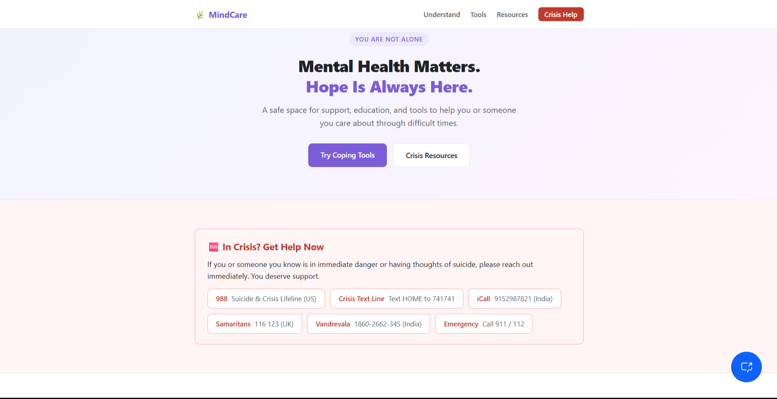
Project Output Screenshot
Please put IBM Bob output screenshots with 2-3 prompts.
You can take 2-3 more slides for each screenshot
·
·
·

Slide 15
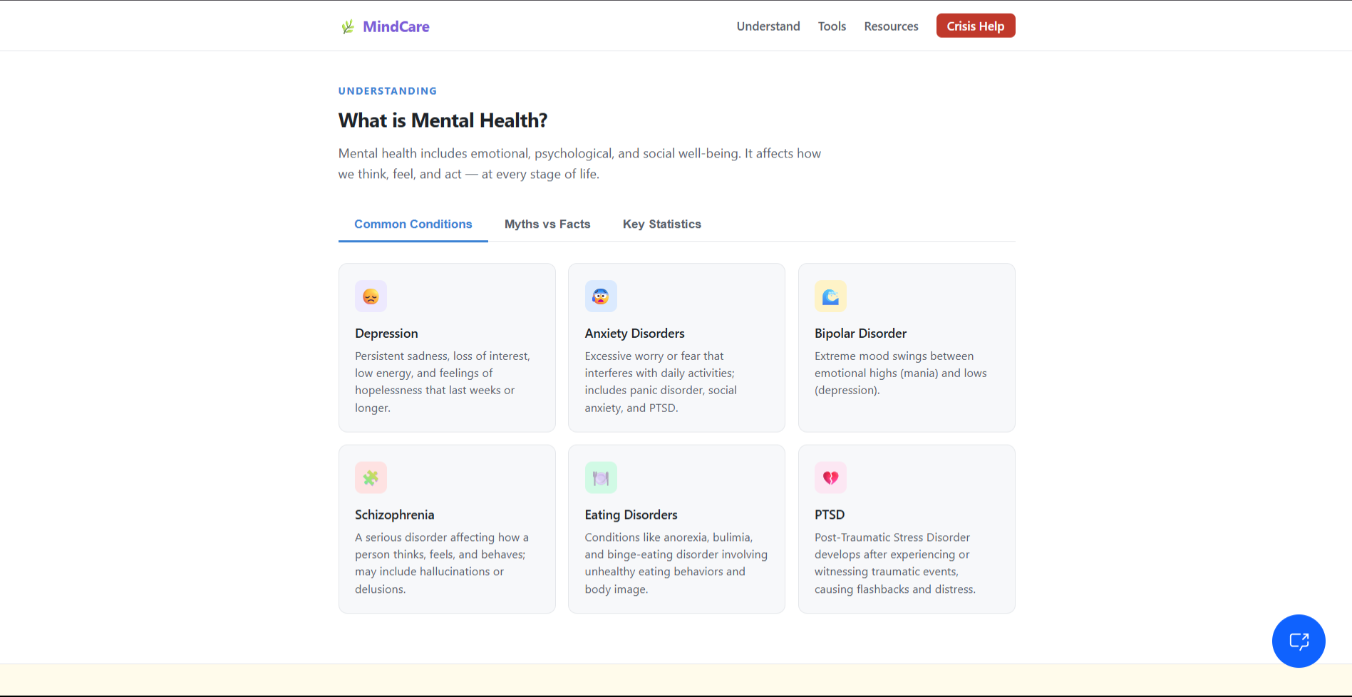
Project Output Screenshot
Please put IBM Bob output screenshots with 2-3 prompts.
You can take 2-3 more slides for each screenshot
·
·
·

Slide 16
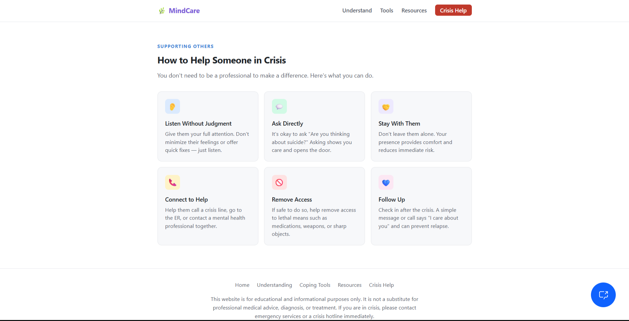
Project Output Screenshot
Please put IBM Bob output screenshots with 2-3 prompts.
You can take 2-3 more slides for each screenshot
·
·
·

Slide 17
Novelty and Uniqueness
What sets this solution apart from traditional mental health apps and simple conversational bots is its shift from reactive, single-prompt assistance to a proactive, clinically-grounded multi-agent ecosystem.
1. Agentic Collaborative Architecture (Beyond Single-Prompt Bots)
Unlike standard chatbots that rely on a single system prompt, this solution operates as a coordinated network of specialized sub-agents orchestrated via IBM watsonx Orchestrate:
Sentiment & Risk Agent: Operates continuously in the background to monitor distress intensity, vocal/text cadence, and risk factors without disrupting conversation flow.
Psychoeducation Agent: Dynamically retrieves evidence-based coping mechanisms (CBT, DBT, mindfulness) tailored to the user’s immediate state.
Emergency & Crisis Triage Agent: Intercepts high-risk scenarios instantly, bypassing standard conversational loops to trigger safety protocols.
2. Dynamic RAG with Safety-First Hallucination Suppression
Traditional LLMs risk generating unverified advice or generic responses during crisis moments.
Clinically Grounded Retrieval: Uses IBM Langflow visual RAG pipelines connected to validated clinical frameworks (PHQ-9, GAD-7, Columbia-Suicide Severity Rating Scale) to ground every response in medically approved guidelines.

Slide 18
Deterministic Guardrails: IBM Granite models enforce hard guardrails—if a suicide risk or severe self-harm signal is detected, generative output is constrained to pre-approved, empathetic crisis intervention pathways and human handoffs.
3. Longitudinal Predictive Prevention vs. Reactive Crisis Management
Most mental health tools only react when a user explicitly asks for help or types a keyword.
Pattern & Trend Forecasting: Analyzes multi-modal logs (journaling entries, voice tone shifts, check-in frequency) over time to identify subtle downward trends or stress build-ups before they reach a critical threshold.
Proactive Micro-Interventions: Gently prompts users with personalized preventive strategies when elevated stress patterns are predicted, preventing acute escalation.
4. Multi-Modal Accessibility with Low Friction
Recognizing that individuals experiencing severe distress or depression often struggle with structured typing:
Accepts text, voice-tone, and free-form daily journaling.
Adapts communication style based on user preference, energy level, and cognitive load.
5. Enterprise-Grade Privacy & Ethical Human-in-the-Loop (HITL)
Zero-Retention Enterprise Security: Built on IBM watsonx.ai to ensure strict data privacy, HIPAA/GDPR alignment, and complete user anonymity for sensitive conversational data.
Seamless Crisis Handoff: Integrates webhooks directly with local emergency crisis lines, counseling networks, and trusted contacts (with prior consent), bridging the gap between digital support and real-world human care.

Slide 19
Git Hub Link
https://github.com/shrenimahadik25-cpu/IBM-CERTIFICATE.git
·
·
·

Slide 20
Future Scope
1. Integration with Wearables & Health Devices
The platform will connect with smartwatches, fitness trackers, and health monitors to analyze biometric markers (e.g., heart rate variability, sleep quality, skin conductance, physical activity).
Physiological Stress Tracking: Correlates real-time biometric anomalies with user journaling to detect physiological stress spikes before emotional burnout occurs.
Proactive Micro-Interventions: Automatically prompts users with grounded breathing exercises or calming micro-content when elevated resting heart rates or disturbed sleep trends indicate heightening anxiety.
2. AI-Powered Voice Assistant & Multilingual Support
To dismantle barriers in crisis management, the agent will offer voice-first interaction and multilingual capabilities via IBM Granite Speech & Multilingual models and IBM Langflow.
Voice-First Interaction: Enables hands-free, natural conversational engagement for users experiencing cognitive fatigue, severe depression, or acute distress.
Linguistic Inclusivity: Supports multi-dialect translation and culturally nuanced empathetic responses, ensuring crucial crisis resources and support are accessible across diverse populations and regions.
·
·
·

Slide 21
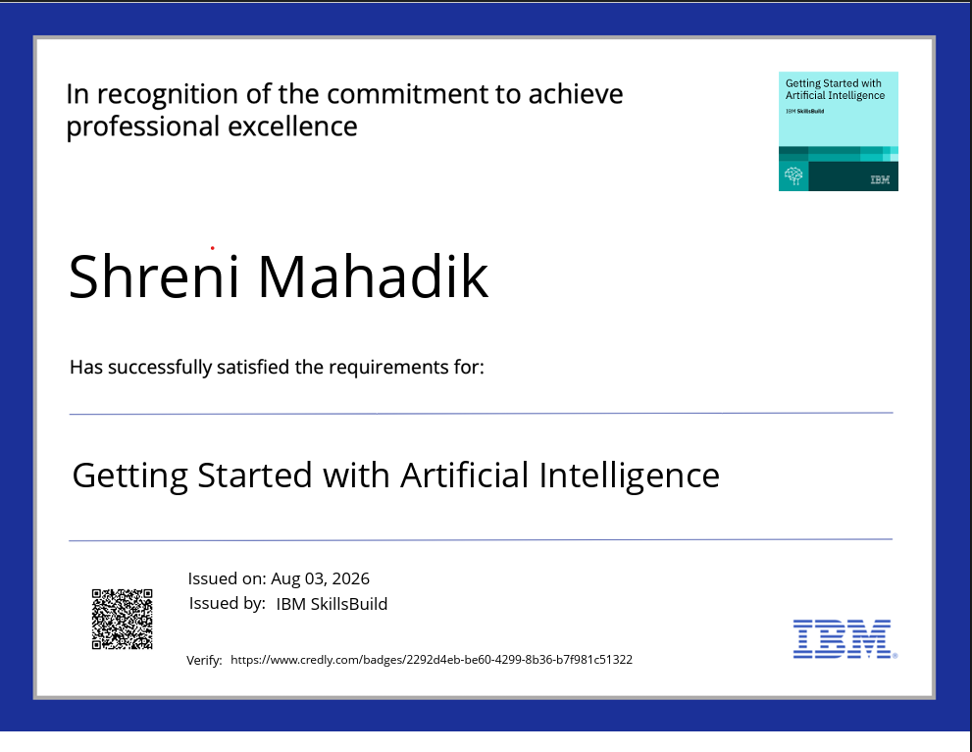
Certificates Earned :

Slide 22
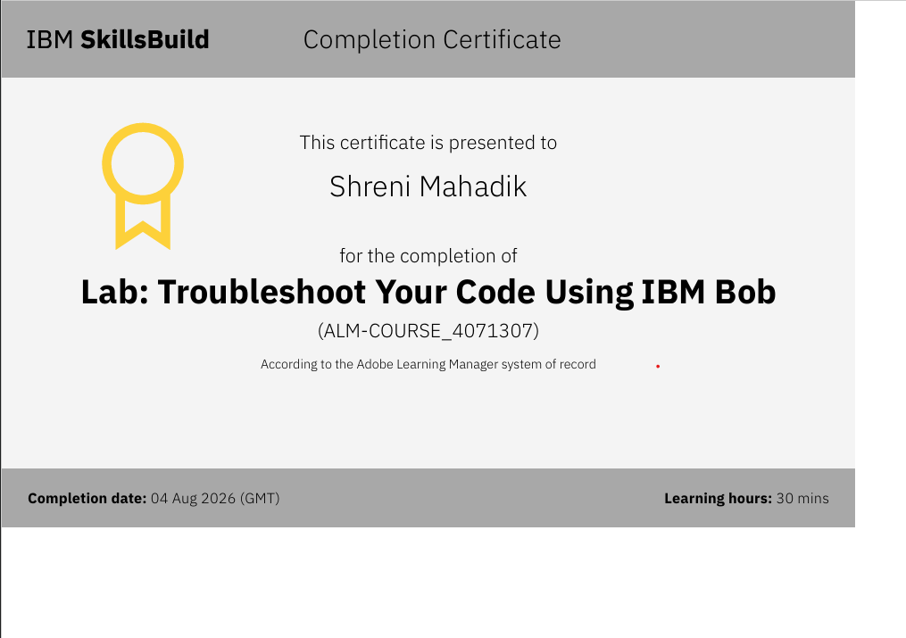
Certificates Earned :​

Slide 23


